Slide 1
Cloud Computing
Amazon Web Service
Content Reference – @Stephen Maarek

Slide 2
Problems with traditional IT approach
Pay rent for the data center
Pay for the power supply, cooling and maintenance
Adding and replacing hardware takes time
Scaling is limited
Hire 24/7 team to monitor the infrastructure
How to deal with disaster

Slide 3
What is Cloud Computing
Cloud computing is On-Demand Delivery of Compute power, Storage, database storage, applications and other IT resources.
Through the cloud service platform with pay-as-you-go pricing
You can provision exactly the right type and size of computing resources you need
You can access as many as you need, almost instantly
Simple way to access servers, storage, databases and set of application services.
AWS own and maintains the network connected hardware required for these application services, while you provision and use what you need via web application

Slide 4

Deployment Models of the Cloud
Private Cloud
Cloud services used by a single organization, not exposed to the public.
Complete control
Security for sensitive applications
Meet specific business needs
Public Cloud
Cloud resources owned and operated by a third party cloud service provider delivered over the Internet
Six Advantages of Cloud Computing
Hybrid Cloud
Keep some servers on premises and extend some capabilities to the Cloud
Control over sensitive assets in your private infrastructure
Flexibility and cost effectiveness of the public cloud

Slide 5
Characteristics of Cloud Computing
On-Demand Self service
Users can provision resources and use them without human interaction from the service provider
Broad Network Access
Resources available over the network, and can be accessed by diverse client platforms
Multitenancy and resource pooling
Multiple customers can share the same infrastructure and applications with security and privacy
Multiple customers are serviced from the same physical resources
Rapid elasticity and scalability
Automatically and quickly acquire and dispose resources when needed
Quickly and easily scale based on demand
Measured service
Usage is measured, users pay correctly for what they have used

Slide 6
Advantages of Cloud Computing
Trade capital expense (CAPEX) for operational expense (OPEX)
Pay On-Demand: don’t own hardware
Reduced Total Cost of Ownership (TCO) & Operational Expense (OPEX)
Benefit from massive economies of scale
Prices are reduced as AWS is more efficient due to large scale
Stop guessing capacity
Scale based on actual measured usage
Increase speed and agility
Stop spending money running and maintaining data centers
Go global in minutes: leverage the AWS global infrastructure

Slide 7
Problems solved by Cloud Computing
Flexibility: change resource types when needed
Cost-Effectiveness: pay as you go, for what you use
Scalability: accommodate larger loads by making hardware stronger or adding additional nodes
Elasticity: ability to scale out and scale-in when needed
High-availability and fault-tolerance: build across data centers
Agility: rapidly develop, test and launch software applications

Slide 8
Types of cloud computing
Infrastructure as a Service (IaaS)
Provide building blocks for cloud IT
Provides networking, computers, data storage space
Highest level of flexibility
Easy parallel with traditional on-premises IT
Platform as a Service (PaaS)
Removes the need for your organization to manage the underlying infrastructure
Focus on the deployment and management of your applications
Software as a Service (SaaS)
Completed product that is run and managed by the service provider

Slide 9
Example AWS Cloud Computing
Infrastructure as a Service:
Amazon EC2 (on AWS)
GCP, Azure, Rackspace, Digital Ocean, Linode
Platform as a Service:
Elastic Beanstalk (on AWS)
Heroku, Google App Engine (GCP), Windows Azure (Microsoft)
Software as a Service:
Many AWS services (ex: Rekognition for Machine Learning)
Google Apps (Gmail), Dropbox, Zoom

Slide 10
AWS Global Infrastructure
AWS Regions
AWS Availability Zones
AWS Data Centers
AWS Edge Locations / Points of Presence

Slide 11
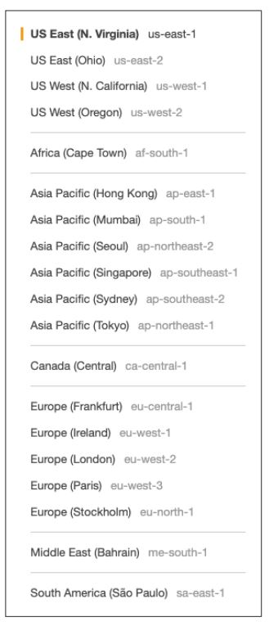
AWS Region
AWS has Regions all around the world
Names can be us-east-1, eu-west-3…
A region is a cluster of data centers
Most AWS services are region-scoped

Slide 12
How to choose AWS Region
Compliance with data governance and legal requirements: data never leaves a region without your explicit permission
Proximity to customers: reduced latency
Available services within a Region: new services and new features aren’t available in every Region
Pricing: pricing varies region to region and is transparent in the service pricing page

Slide 13
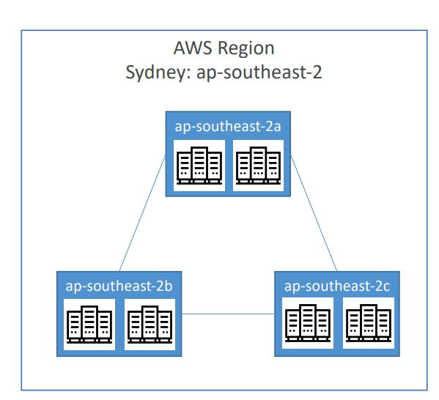
AWS Availability Zones
Each region has many availability zones (usually 3, min is 2, max is 6). Example:
ap-southeast-2a
ap-southeast-2b
ap-southeast-2c
Each availability zone (AZ) is one or more discrete data centers with redundant power, networking, and connectivity
They’re separate from each other, so that
they’re isolated from disasters
They’re connected with high bandwidth, ultra-low latency networking

Slide 14
AWS points of Presence – Edge Locations
Amazon has 216 Points of Presence (205 Edge Locations & 11 Regional Caches) in 84 cities across 42 countries
Content is delivered to end users with lower latency

Slide 15
AWS Services – Global and Region Scoped
AWS has Global Services:
Identity and Access Management (IAM)
Route 53 (DNS service)
CloudFront (Content Delivery Network)
WAF (Web Application Firewall)
Most AWS services are Region-scoped:
Amazon EC2 (Infrastructure as a Service)
Elastic Beanstalk (Platform as a Service)
Lambda (Function as a Service)
Rekognition (Software as a Service)

Slide 16
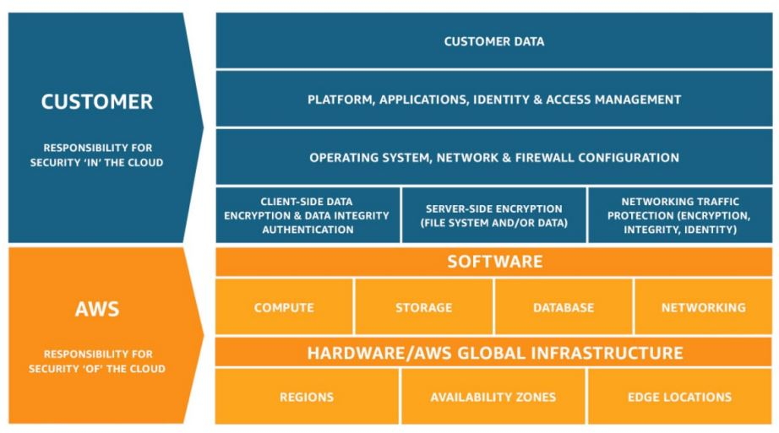
Shared Responsibility Model
CUSTOMER = RESPONSIBILITY FOR THE SECURITY IN THE CLOUD
AWS = RESPONSIBILITY FOR THE SECURITY OF THE CLOUD

Slide 17
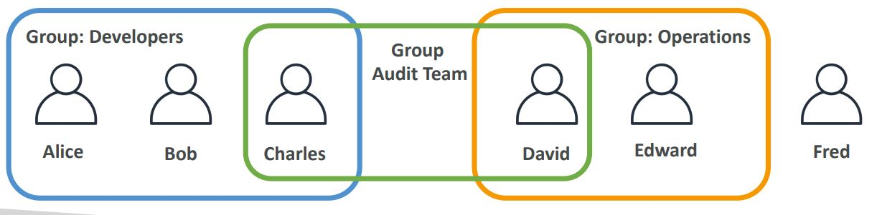
IAM Users and Groups
IAM = Identity and Access Management, Global service
Root account created by default, shouldn’t be used or shared
Users are people within your organization, and can be grouped
Groups only contain users, not other groups
Users don’t have to belong to a group, and user can belong to multiple groups

Slide 18
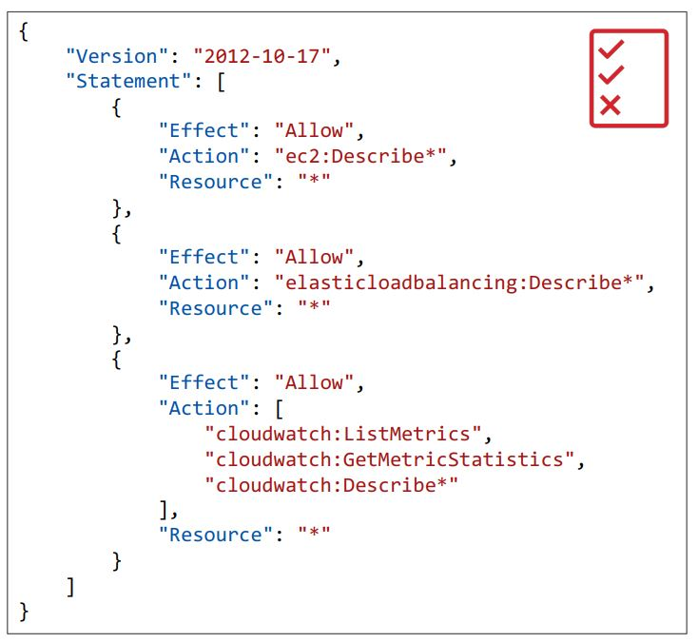
IAM : Permissions
Users or Groups can be assigned JSON documents called policies
These policies define the permissions of the users
In AWS you apply the least privilege principle: don’t give more permissions than a user needs

Slide 19
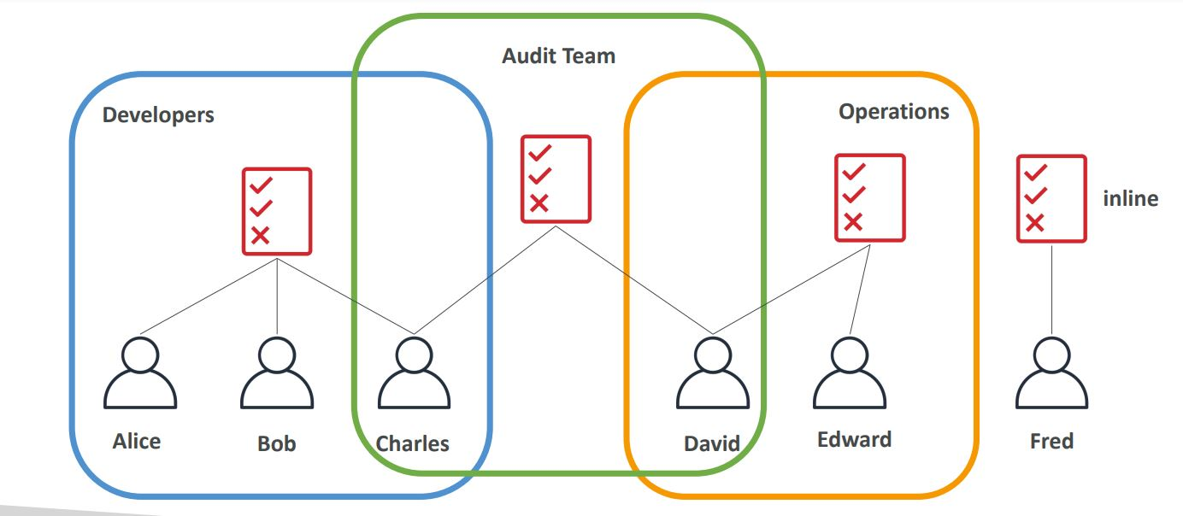
IAM Policies Inheritance

Slide 20
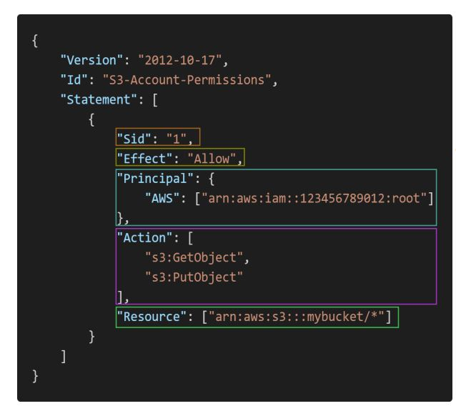
IAM Policy Structure
Consists of
Version: policy language version, always include “2012 -10 - 17”
Id: an identifier for the policy (optional)
Statement: one or more individual statements (required)
Statements consists of
Sid: an identifier for the statement (optional)
Effect: whether the statement allows or denies access (Allow, Deny)
Principal: account/user/role to which this policy applied to
Action: list of actions this policy allows or denies
Resource: list of resources to which the actions applied to
Condition: conditions for when this policy is in effect (optional)

Slide 21
Multi – Factor Authentication MFA
Users have access to your account and can possibly change configurations or delete resources in your AWS account
You want to protect your Root Accounts and IAM users
MFA = password you know + security device you own
Main benefit of MFA: if a password is stolen or hacked, the account is not compromised

Slide 22
IAM Roles for Services
Some AWS service will need to perform actions on your behalf
To do so, we will assign permissions to AWS services with IAM Roles
Common roles:
EC2 Instance Roles
Lambda Function Roles
Roles for CloudFormation

Slide 23
IAM Guidelines and Best Practices
Don’t use the root account except for AWS account setup
One physical user = One AWS user
Assign users to groups and assign permissions to groups
Create a strong password policy
Use and enforce the use of Multi Factor Authentication (MFA)
Create and use Roles for giving permissions to AWS services
Use Access Keys for Programmatic Access (CLI / SDK)
Audit permissions of your account with the IAM Credentials Report
Never share IAM users & Access Keys

Slide 24
IAM Section - Summary
Users: mapped to a physical user, has a password for AWS Console
Groups: contains users only
Policies: JSON document that outlines permissions for users or groups
Roles: for EC2 instances or AWS services
Security: MFA + Password Policy
AWS CLI: manage your AWS services using the command-line
AWS SDK: manage your AWS services using a programming language
Access Keys: access AWS using the CLI or SDK
Audit: IAM Credential Reports & IAM Access Advisor

Slide 25
Compute Service - EC2
EC2 – Elastic Compute Cloud
EC2 is one of the most popular of AWS’ offering
EC2 = Elastic Compute Cloud = Infrastructure as a Service
It mainly consists in the capability of :
Renting virtual machines (EC2)
Storing data on virtual drives (EBS) - volume – 30 GB
Distributing load across machines (ELB)
Scaling the services using an auto-scaling group (ASG)

Slide 26
EC2 sizing & configuration options
Operating System (OS): Linux, Windows or Mac OS
How much compute power & cores (CPU)
How much random-access memory (RAM)
How much storage space:
Network-attached (EBS & EFS)
Hardware (EC2 Instance Store)
Network card: speed of the card, Public IP address
Firewall rules: security group
Bootstrap script (configure at first launch): EC2 User Data

Slide 27
EC2 User Data
It is possible to bootstrap our instances using an EC2 User data script.
bootstrapping means launching commands when a machine starts
That script is only run once at the instance first start
EC2 user data is used to automate boot tasks such as:
Installing updates
Installing software
Downloading common files from the internet
Anything you can think of
The EC2 User Data Script runs with the root user

Slide 28
EC2 Instance Types - Overview
You can use different types of EC2 instances that are optimized for different use cases -
General purpose (T) – t2.micro (free-tier)
Compute optimized(C) - c5d.4xlarge
Memory optimized(R) - r5.16xlarge
Storage optimized (I) - Im4gn.large
AWS has the following naming convention:
m5.2xlarge
m: instance class
5: generation (AWS improves them over time)
2xlarge: size within the instance class

Slide 29
EC2 Instances Purchasing Options
On-Demand Instances – short workload, predictable pricing, pay by second
Reserved (1 & 3 years)
Reserved Instances – long workloads
Convertible Reserved Instances – long workloads with flexible instances
Savings Plans (1 & 3 years) –commitment to an amount of usage, long workload
Spot Instances – short workloads, cheap, can lose instances (less reliable)
Dedicated Hosts – book an entire physical server, control instance placement
Dedicated Instances – no other customers will share your hardware
Capacity Reservations – reserve capacity in a specific AZ for any duration

Slide 30
Which purchasing option is right for me?
On demand: coming and staying in resort whenever we like, we pay the full price
Reserved: like planning ahead and if we plan to stay for a long time, we may get a good discount.
Savings Plans: pay a certain amount per hour for certain period and stay in any room type (e.g., King, Suite, Sea View, …)
Spot instances: the hotel allows people to bid for the empty rooms and the highest bidder keeps the rooms. You can get kicked out at any time
Dedicated Hosts: We book an entire building of the resort
Capacity Reservations: you book a room for a period with full price even you don’t stay in it

Slide 31
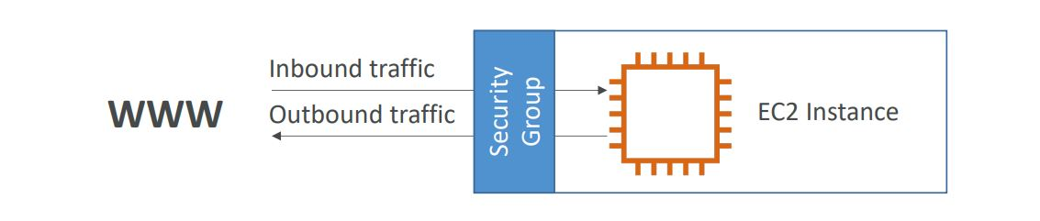
Introduction to Security Groups
Security Groups are the fundamental of network security in AWS
They control how traffic is allowed into or out of our EC2 Instances.
Security groups only contain allow rules
Security groups rules can reference by IP or by security group

Slide 32
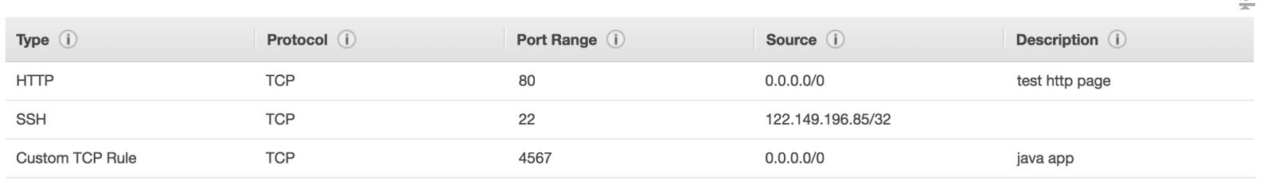
Security Groups
Security groups are acting as a “firewall” on EC2 instances
They regulate:
Access to Ports
Authorized IP ranges – IPv4 and IPv6
Control of inbound network (from other to the instance)
Control of outbound network (from the instance to other)

Slide 33
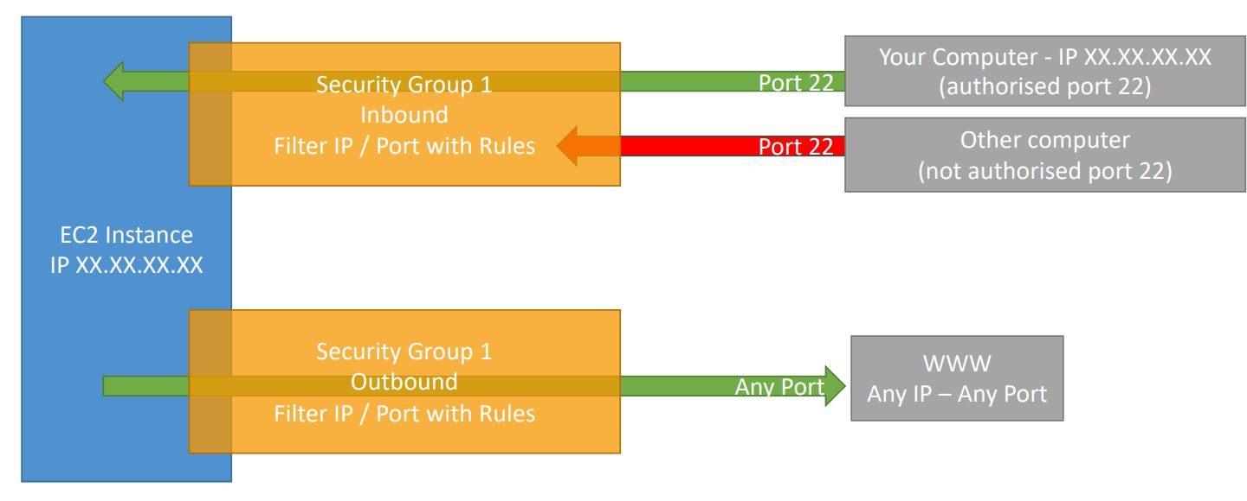
Security Group - Example

Slide 34
Security Groups Good to know
Can be attached to multiple instances
Locked down to a region / VPC combination
Does live “outside” the EC2 – if traffic is blocked the EC2 instance won’t see it
It’s good to maintain one separate security group for SSH access
If your application is not accessible (time out), then it’s a security group issue
If your application gives a “connection refused“ error, then it’s an application error or it’s not launched
All inbound traffic is blocked by default
All outbound traffic is authorized by default

Slide 35
Classic Ports
22 = SSH (Secure Shell) - log into a Linux instance
21 = FTP (File Transfer Protocol) – upload files into a file share
22 = SFTP (Secure File Transfer Protocol) – upload files using SSH
80 = HTTP – access unsecured websites
443 = HTTPS – access secured websites
3389 = RDP (Remote Desktop Protocol) – log into a Windows instance

Slide 36
EC2 Section – Summary
EC2 Instance: AMI (OS) + Instance Size (CPU + RAM) + Storage + security groups + EC2 User Data
Security Groups: Firewall attached to the EC2 instance
EC2 User Data: Script launched at the first start of an instance
SSH: start a terminal into our EC2 Instances (port 22)
EC2 Instance Role: link to IAM roles
Purchasing Options: On-Demand, Spot, Reserved (Standard + Convertible + Scheduled), Dedicated Host, Dedicated Instance

Slide 37
EC2 Instance Storage – EBS Volume
An EBS (Elastic Block Store) Volume is a network drive you can attach to your instances while they run
It allows your instances to persist data, even after their termination
They can only be mounted to one instance at a time
They are bound to a specific availability zone
Analogy: Think of them as a “network USB stick”
Free tier: 30 GB of free EBS storage of type General Purpose (SSD) or Magnetic per month

Slide 38
EBS Volume
It’s a network drive (i.e. not a physical drive)
It uses the network to communicate the instance, which means there might be a bit of latency
It can be detached from an EC2 instance and attached to another one quickly
It’s locked to an Availability Zone (AZ)
An EBS Volume in us-east-1a cannot be attached to us-east-1b
To move a volume across, you first need to snapshot it
Have a provisioned capacity (size in GBs, and IOPS)
You get billed for all the provisioned capacity
You can increase the capacity of the drive over time

Slide 39
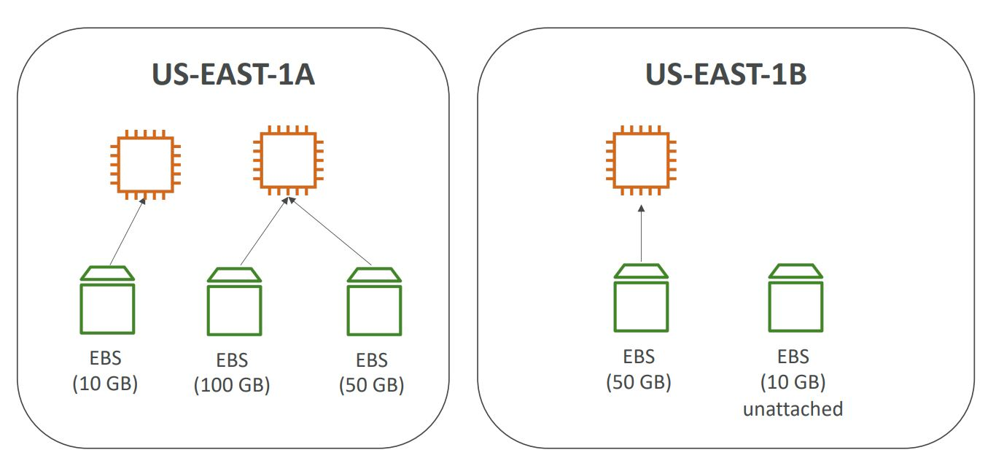
EBS Volume - Example

Slide 40
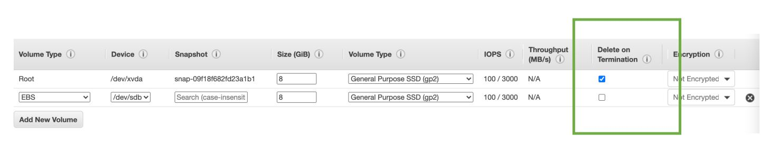
EBS – Delete on Termination attribute
Controls the EBS behavior when an EC2 instance terminates
By default, the root EBS volume is deleted (attribute enabled)
By default, any other attached EBS volume is not deleted (attribute disabled)
This can be controlled by the AWS console / AWS CLI
Use case: preserve root volume when instance is terminated

Slide 41
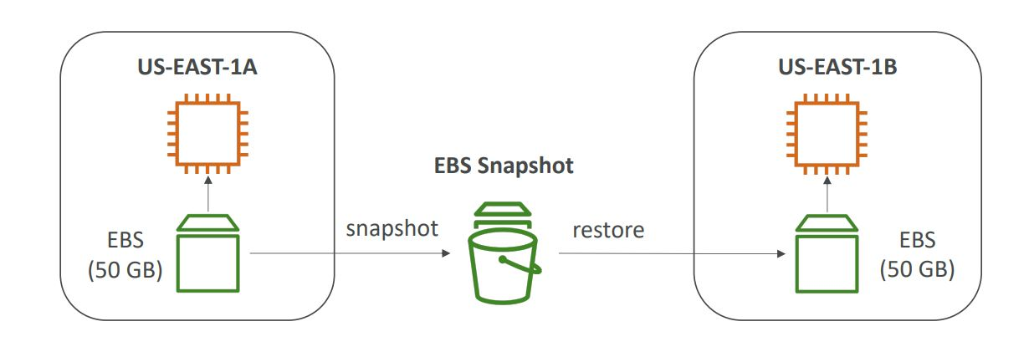
EBS Snapshot
Make a backup (snapshot) of your EBS volume at a point in time
Not necessary to detach volume to do snapshot, but recommended
Can copy snapshots across AZ or Region

Slide 42
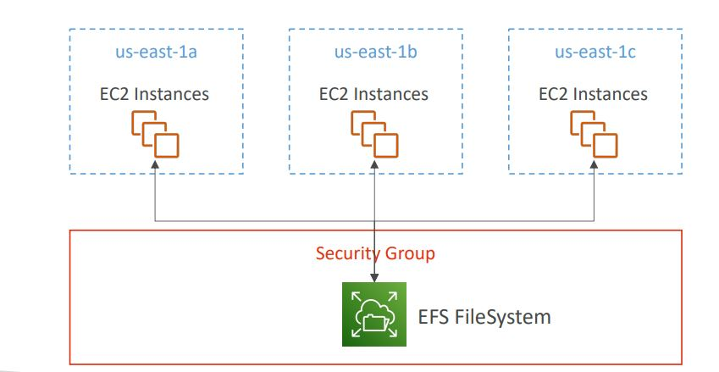
EFS – Elastic File System
Managed NFS (network file system) that can be mounted on 100s of EC2
EFS works with Linux EC2 instances in multi-AZ
Highly available, scalable, expensive (3x gp2), pay per use, no capacity planning

Slide 43
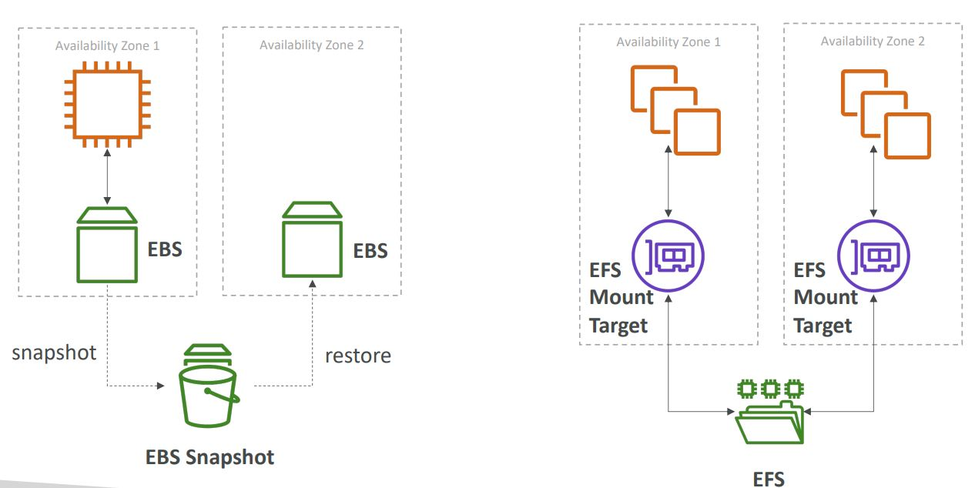
EBS vs EFS

Slide 44
EC2 Instance Storage - Summary
EBS volumes:
Network drives attached to one EC2 instance at a time
Mapped to an Availability Zones
can use EBS Snapshots for backups / transferring EBS volumes across AZ
AMI: create ready-to-use EC2 instances with our customizations
EC2 Image Builder: automatically build, test and distribute AMIs
EC2 Instance Store:
High performance hardware disk attached to our EC2 instance
Lost if our instance is stopped / terminated
EFS: network file system, can be attached to 100s of instances in a region
EFS-IA: cost-optimized storage class for infrequent accessed files
FSx for Windows: Network File System for Windows servers
FSx for Lustre: High Performance Computing Linux file system

Slide 45
Scalability & High Availability
Scalability means that an application / system can handle greater loads by adapting.
There are two kinds of scalability:
Vertical Scalability
Horizontal Scalability (= elasticity)
Scalability is linked but different to High Availability

Slide 46
Vertical Scalability
Vertical Scalability means increasing the size of the instance
For example, your application runs on a t2.micro
Scaling that application vertically means running it on a t2.large
Vertical scalability is very common for non distributed systems, such as a database.
There’s usually a limit to how much you can vertically scale (hardware limit)

Slide 47
Horizontal Scalability
Horizontal Scalability means increasing the number of instances / systems for your application
Horizontal scaling implies distributed systems.
This is very common for web applications / modern applications
It’s easy to horizontally scale thanks the cloud offerings such as Amazon EC2

Slide 48
High Availability
High Availability usually goes hand in hand with horizontal scaling
High availability means running your application / system in at least 2 Availability Zones
The goal of high availability is to survive a data center loss (disaster)

Slide 49
High Availability & Scalability For EC2
Vertical Scaling: Increase instance size (= scale up / down)
From: t2.nano - 0.5G of RAM, 1 vCPU
To: u-12tb1.metal – 12.3 TB of RAM, 448 vCPUs
Horizontal Scaling: Increase number of instances (= scale out / in)
Auto Scaling Group
Load Balancer
High Availability: Run instances for the same application across multi AZ
Auto Scaling Group multi AZ
Load Balancer multi AZ

Slide 50
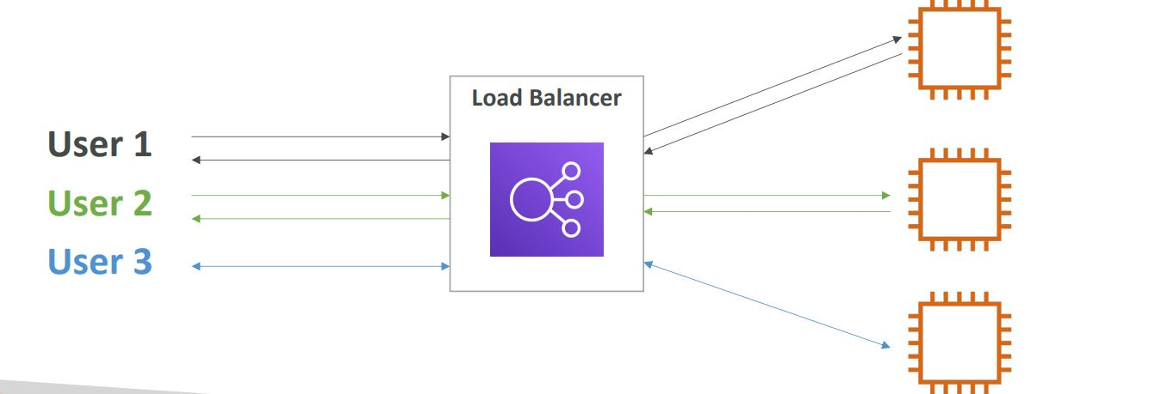
What is load balancing?
Load balancers are servers that forward internet traffic to multiple servers (EC2 Instances) downstream.

Slide 51
Why use a load balancer?
Spread load across multiple downstream instances
Expose a single point of access (DNS) to your application
Seamlessly handle failures of downstream instances
Do regular health checks to your instances
Provide SSL termination (HTTPS) for your websites
High availability across zones

Slide 52
Why use an Elastic Load Balancer?
An ELB (Elastic Load Balancer) is a managed load balancer
AWS guarantees that it will be working
AWS takes care of upgrades, maintenance, high availability
AWS provides only a few configuration knobs
It costs less to setup your own load balancer but it will be a lot more effort on your end (maintenance, integrations)
3 kinds of load balancers offered by AWS:
Application Load Balancer (HTTP / HTTPS only) – Layer 7
Network Load Balancer (ultra-high performance, allows for TCP) – Layer 4
Classic Load Balancer (slowly retiring) – Layer 4 & 7

Slide 53
What’s an Auto Scaling Group?
In real-life, the load on your websites and application can change
In the cloud, you can create and get rid of servers very quickly
The goal of an Auto Scaling Group (ASG) is to:
Scale out (add EC2 instances) to match an increased load
Scale in (remove EC2 instances) to match a decreased load
Ensure we have a minimum and a maximum number of machines running
Automatically register new instances to a load balancer
Replace unhealthy instances
Cost Savings: only run at an optimal capacity (principle of the cloud)

Slide 54
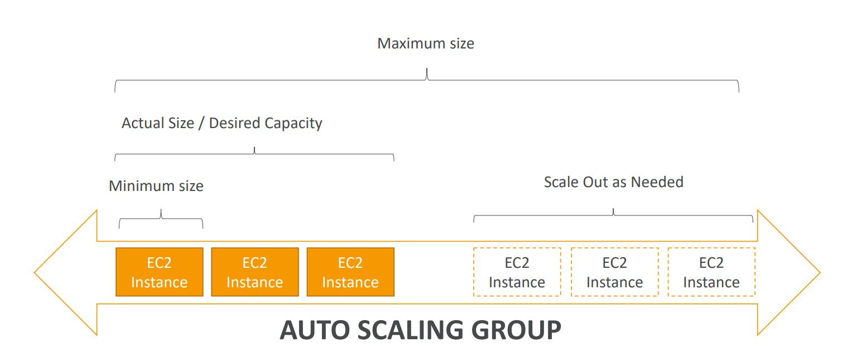
ASG

Slide 55
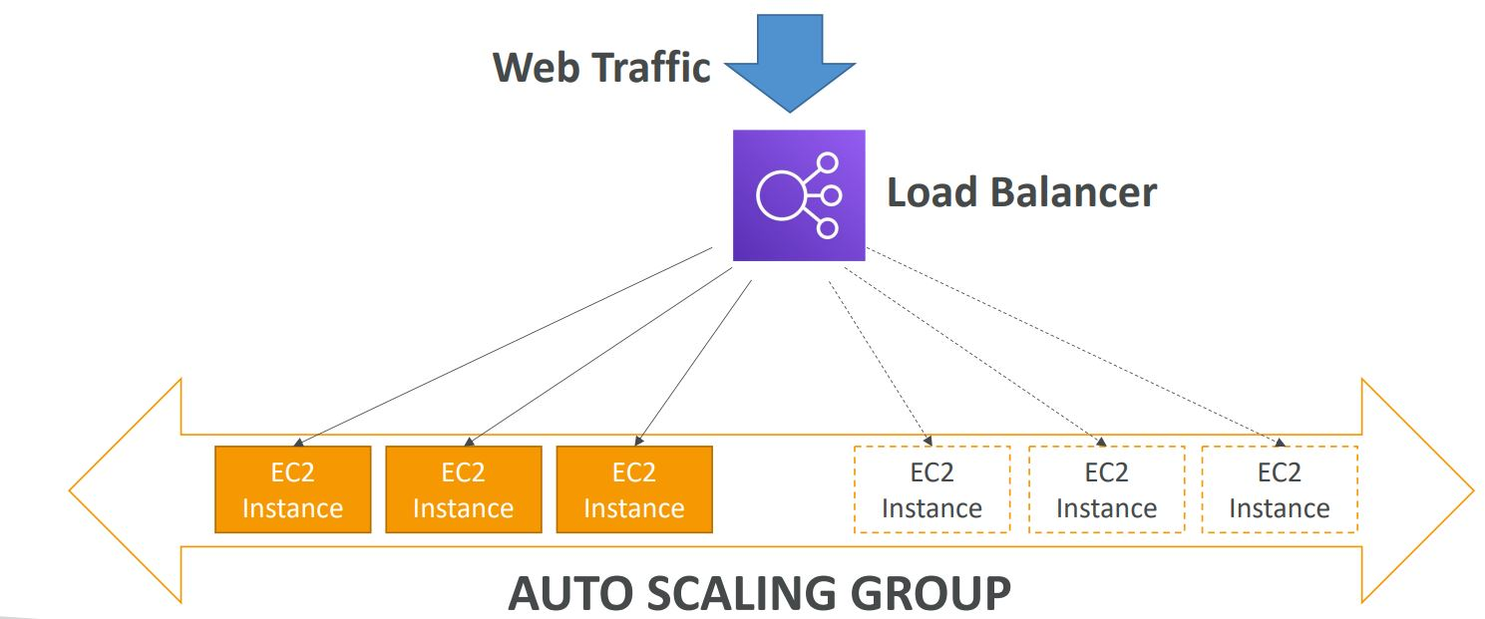
Auto Scaling Group in AWS With Load Balancer

Slide 56
Auto Scaling Groups – Scaling Strategies
Manual Scaling: Update the size of an ASG manually
Dynamic Scaling: Respond to changing demand
Simple / Step Scaling
When a CloudWatch alarm is triggered (example CPU > 70%), then add 2 units
When a CloudWatch alarm is triggered (example CPU < 30%), then remove 1
Target Tracking Scaling
Example: I want the average ASG CPU to stay at around 40%
Scheduled Scaling
Anticipate a scaling based on known usage patterns
Example: increase the min. capacity to 10 at 5 pm on Fridays

Slide 57
ELB & ASG – Summary
High Availability vs Scalability (vertical and horizontal) vs Elasticity vs Agility in the Cloud
Elastic Load Balancers (ELB)
Distribute traffic across backend EC2 instances, can be Multi-AZ
Supports health checks
3 types: Application LB (HTTP – L7), Network LB (TCP – L4), Classic LB (old)
Auto Scaling Groups (ASG)
Implement Elasticity for your application, across multiple AZ
Scale EC2 instances based on the demand on your system, replace unhealthy
Integrated with the ELB

